Slide 1
WNTE Summary
Ariga
University of Bern

Slide 2
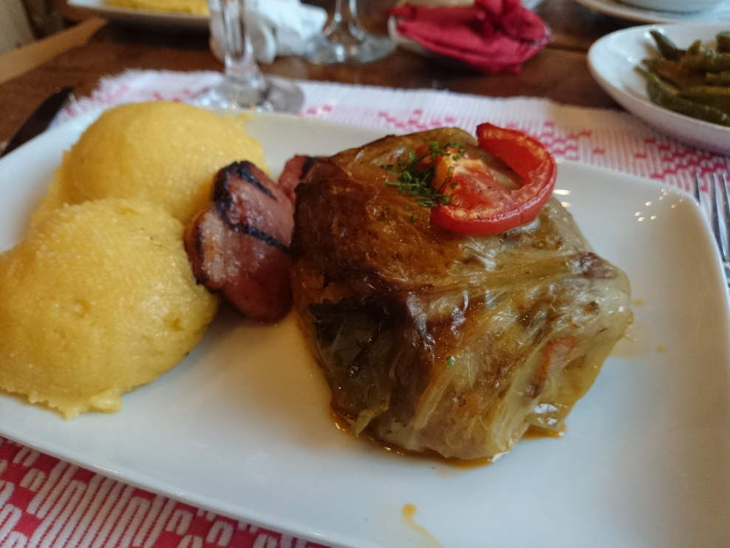
WNTE

Slide 3
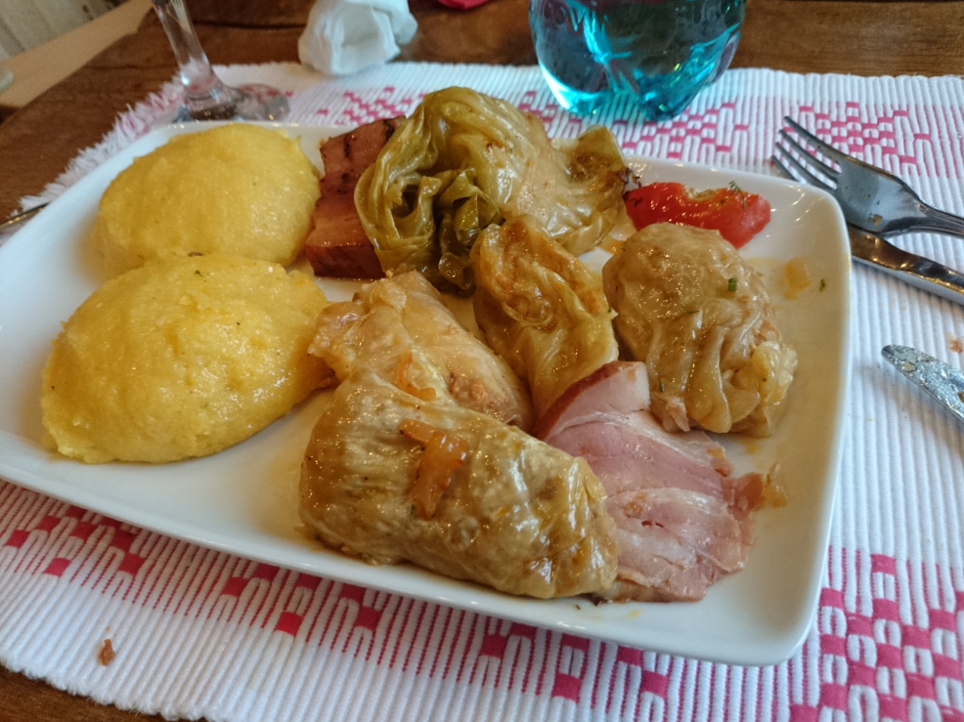
WNTE

Slide 4
Sinaia
Astroparticle Physics
Applications
Brasov
Neutrino Physics
Nuclear Physics
Emulsion Technology

Slide 5
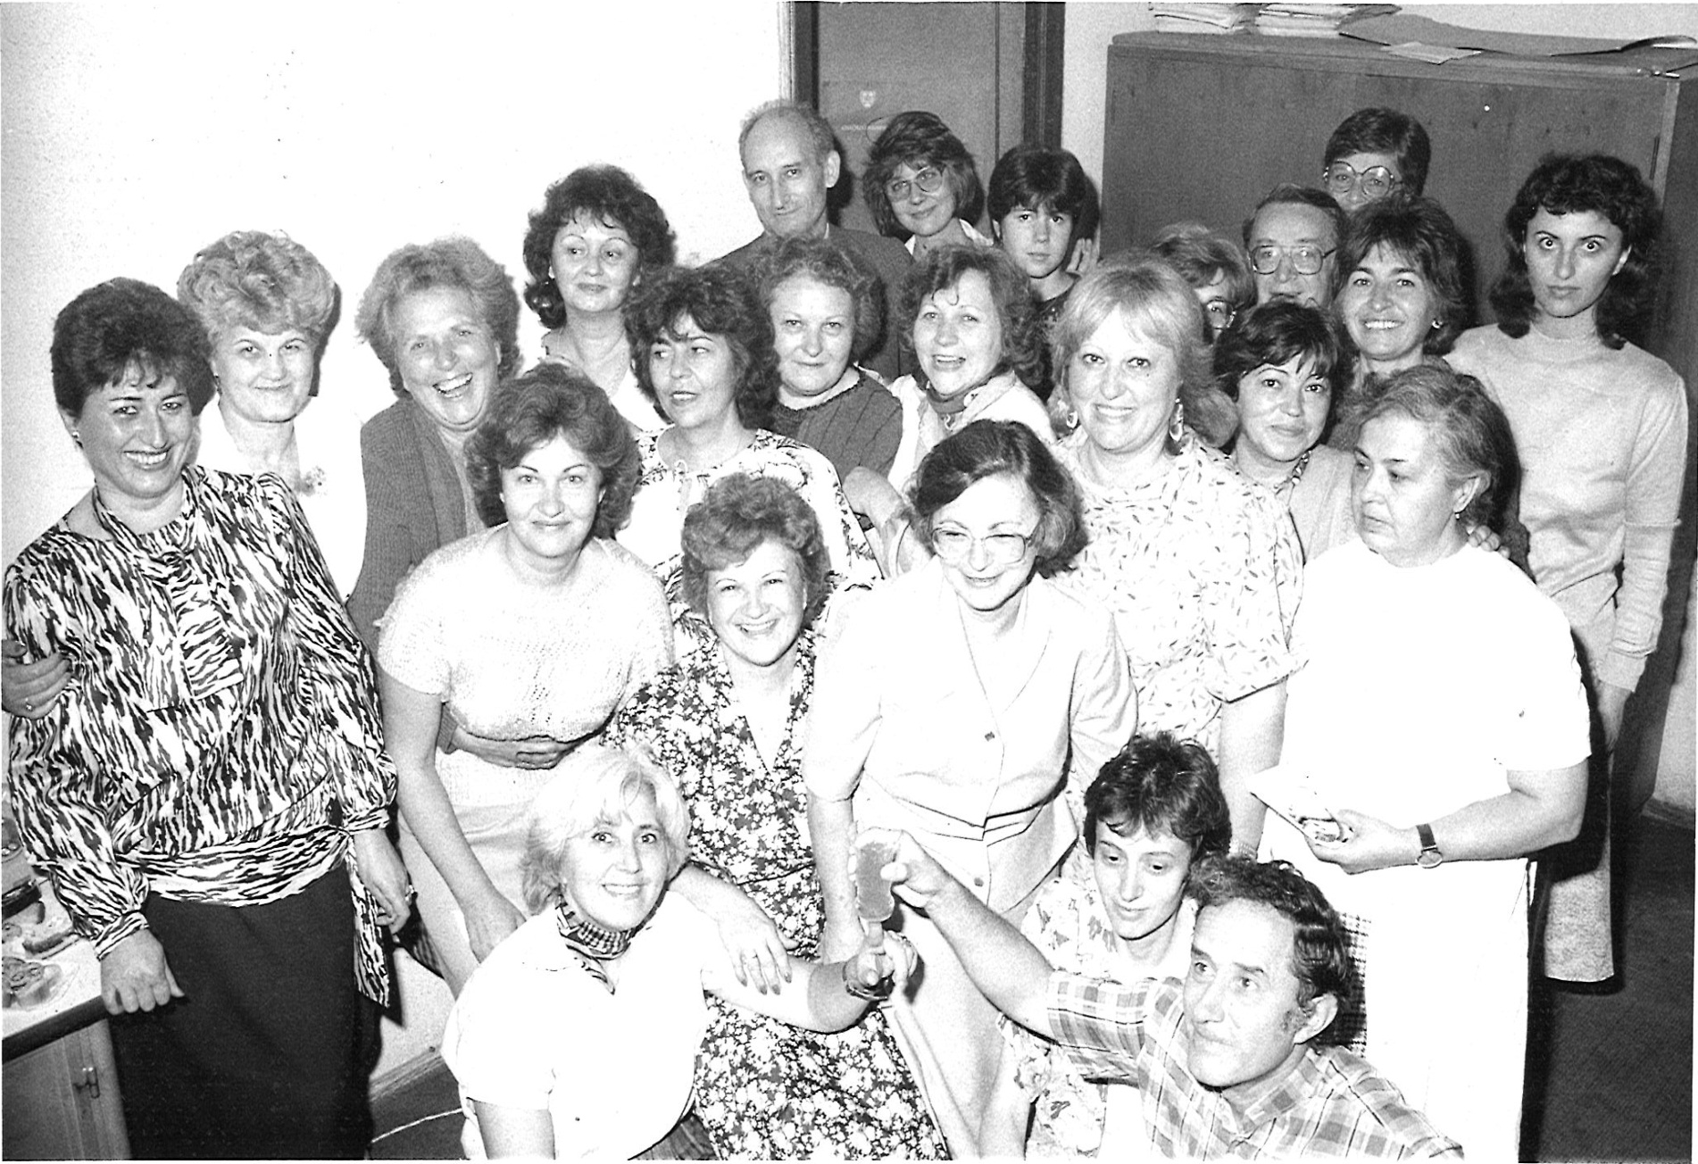
THE COSMETIC LABORATORY
M. Haiduc

Slide 6
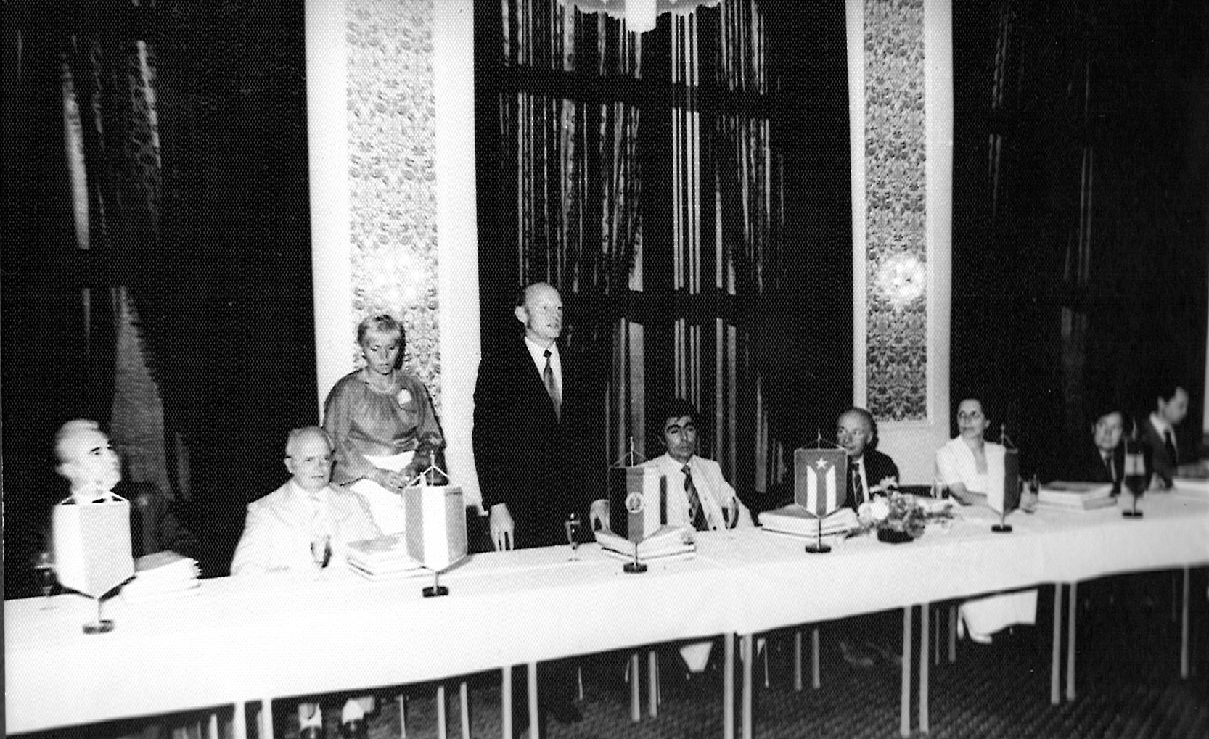
M. Haiduc
Intercosmos

Slide 7

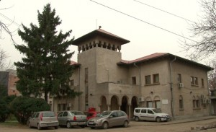

S. Zgura
What is ISS?
INSTITUTE OF SPACE SCIENCE
legal subsidiary of the
National Institute for Laser, Plasma and Radiation Physics (INFLPR)
(http://www.spacescience.ro)

Slide 8
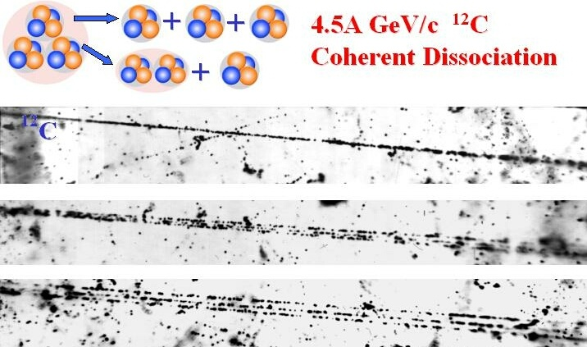

P. Zarubin
White star

Slide 9
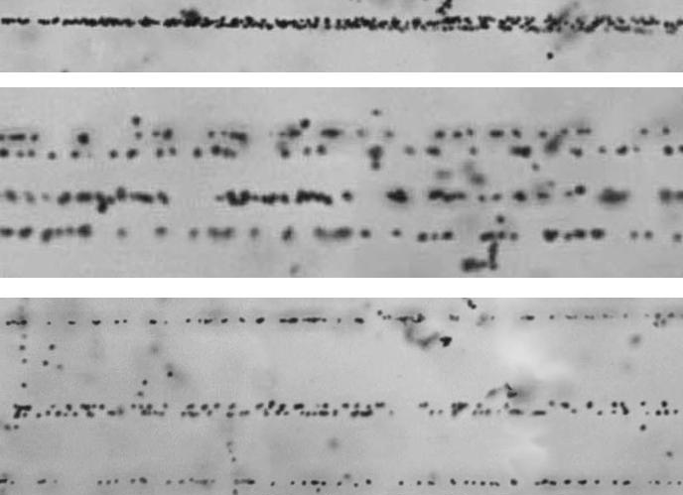
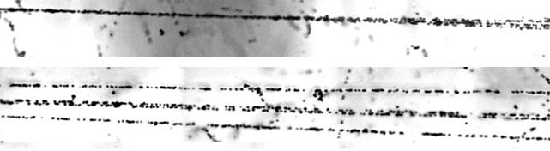
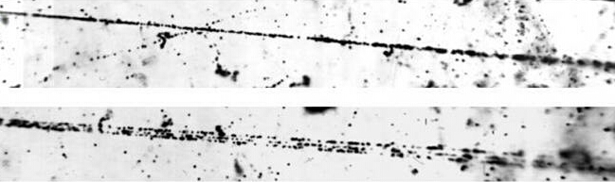
²⁴Mg → 6α
²²Ne → 5α
¹⁶O → 4α
¹²C → 3α

Slide 10
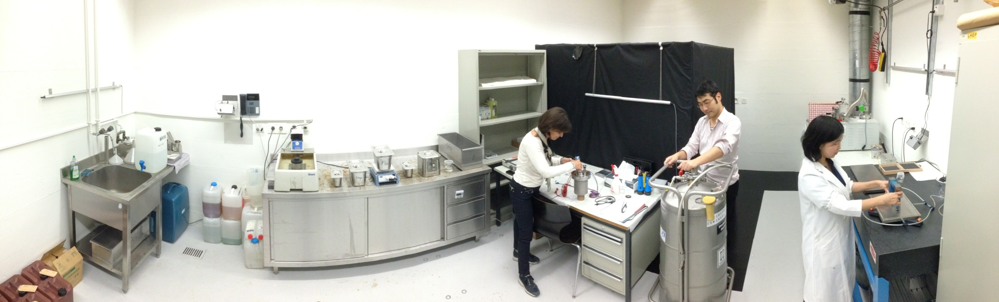
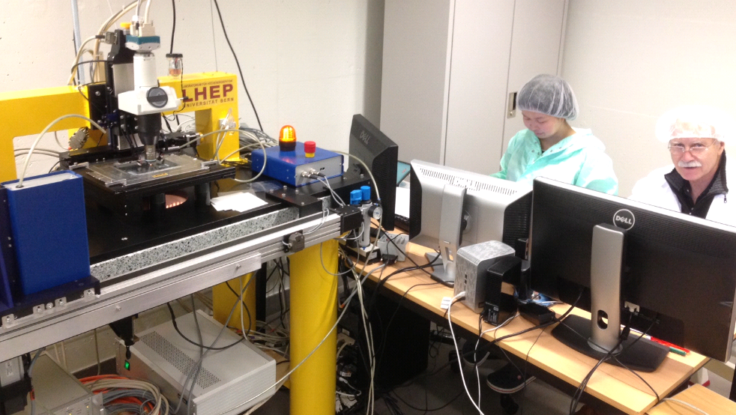
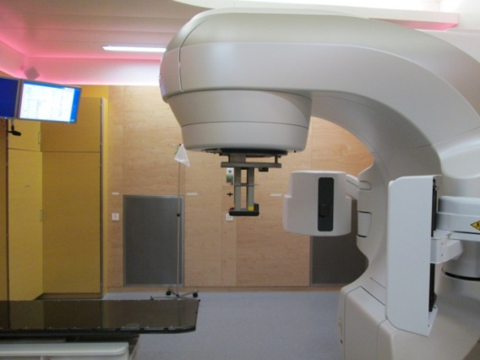
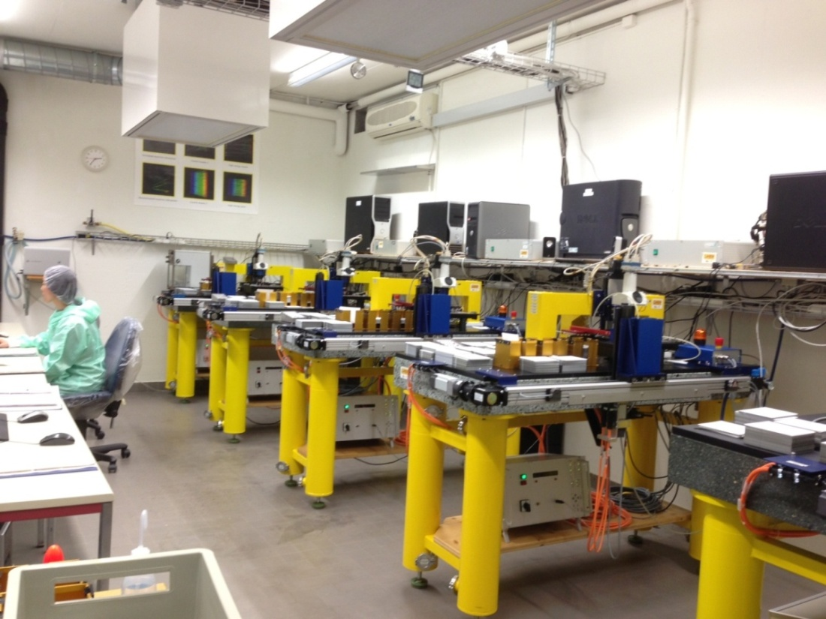
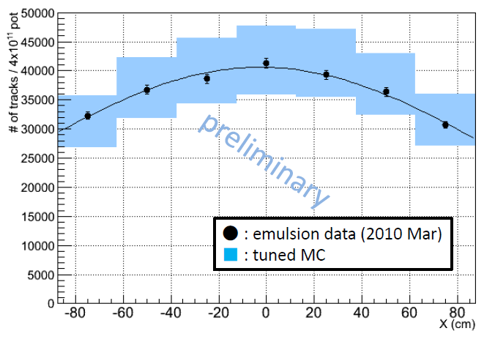
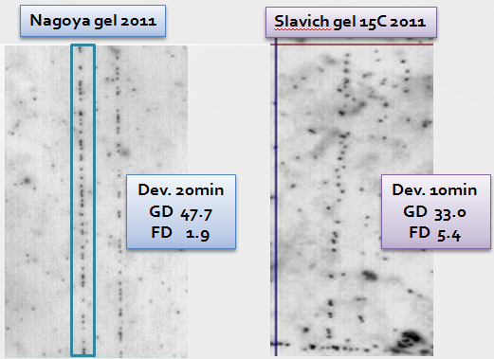
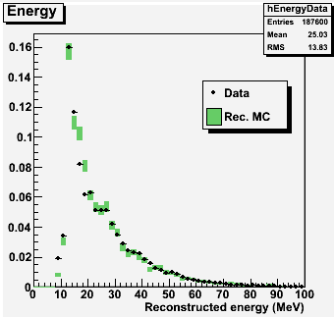
Novel Emulsion R&D in Bern
T. Ariga
Infrastructures for R&D available in Bern
Underground lab, 30 m deep
Film production
Performance check
Development
Automatic microscopes
Electron beam in Bern
Absolute muon meas. in T2K
22MeV electron
OR
CERN and PSI
Proton beam
in Bern
OPERA experiment
AEgIS experiment
Beam monitoring
Medical applications
Muon radiography
Neutron spectrum measurement

Slide 11
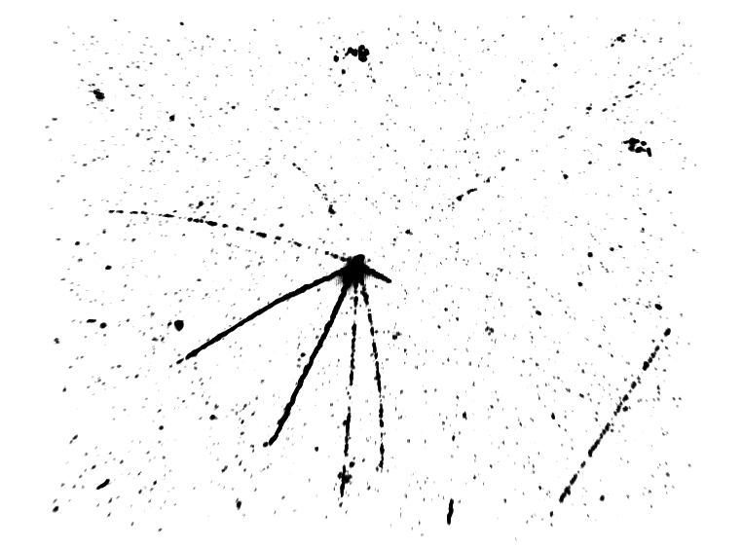
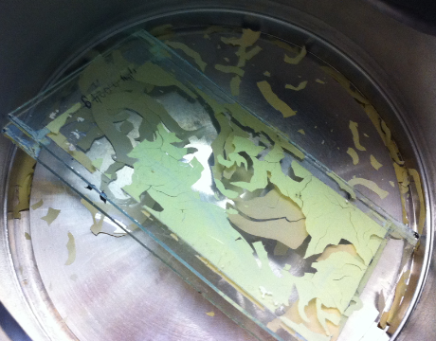
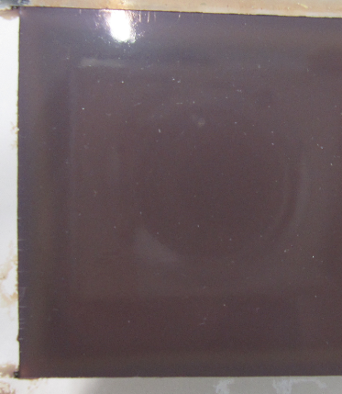
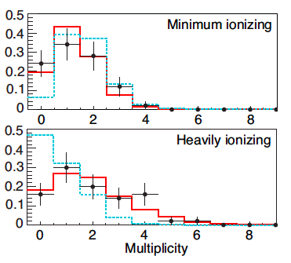
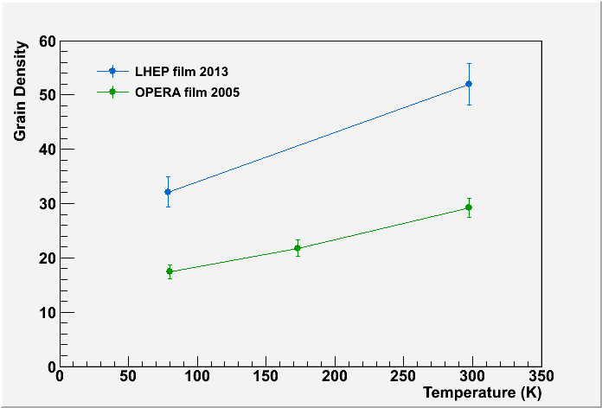
AEgIS experiment
Meas. of gravity on antimatter
A. Ariga
Anti-Hydrogen beam
~10 μm
detector (matter)
H
20 cm
antimatter
Normal emulsion in vacuum
Glycerin added emulsion
Antiproton beam at CERN
2012 run
Emulsion in cryogenics

Slide 12
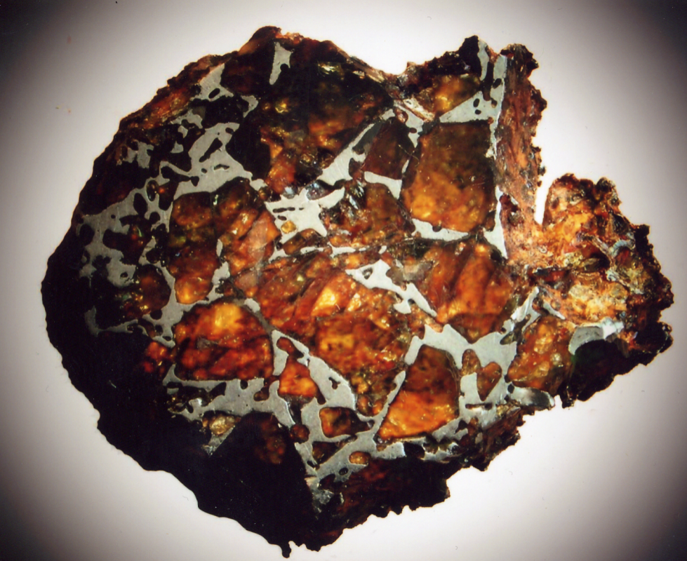
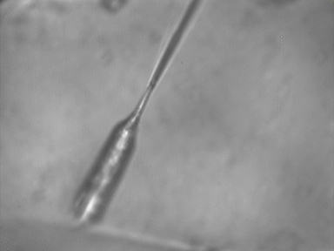
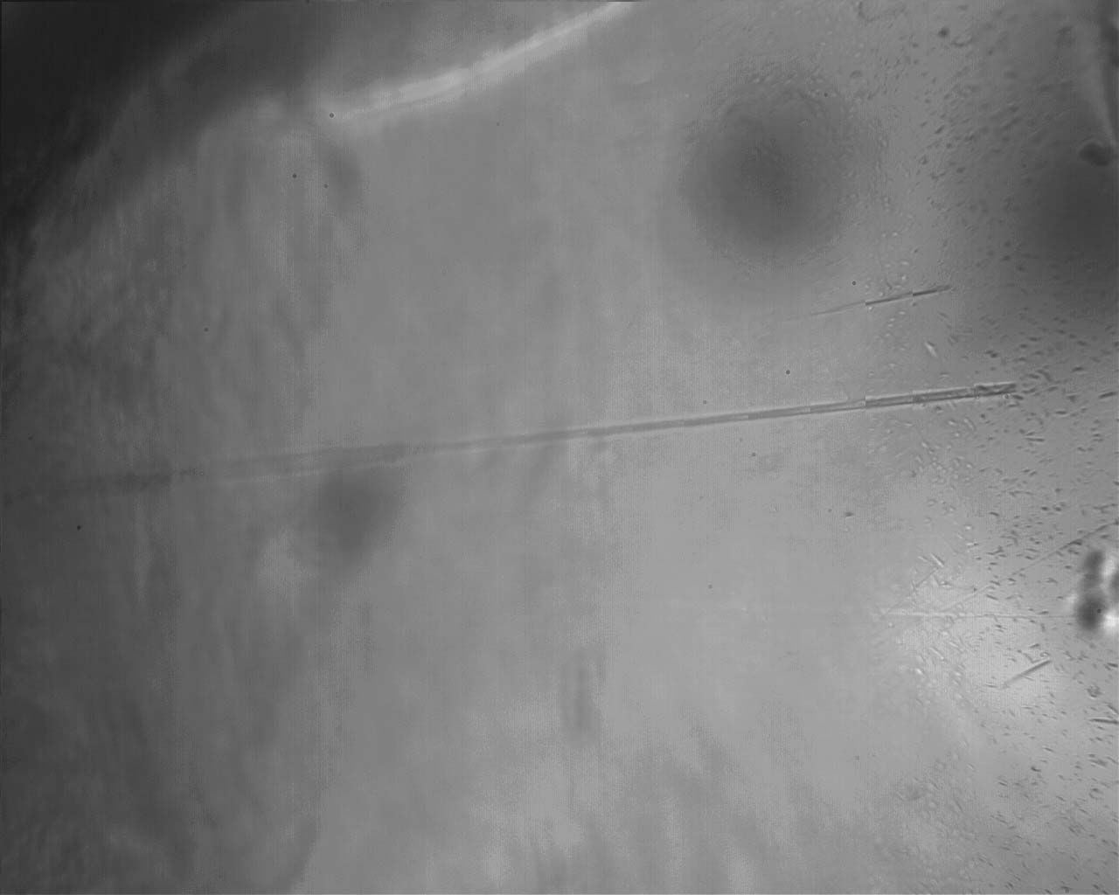
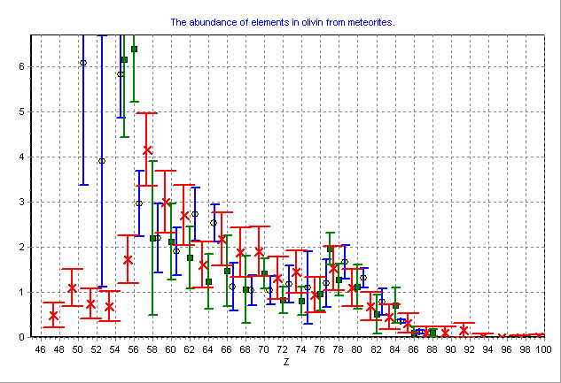
Search for Superheavy Elements in Galactic Cosmic Rays
N. Polukhina
50 μm
The galactic nuclei abundance A (A_{Fe}= 10⁶)
(■ - HEAO; o – Ariel; x – our results)
365 μm
185 μm
three events whose charges are estimated 105<Z<130

Slide 13
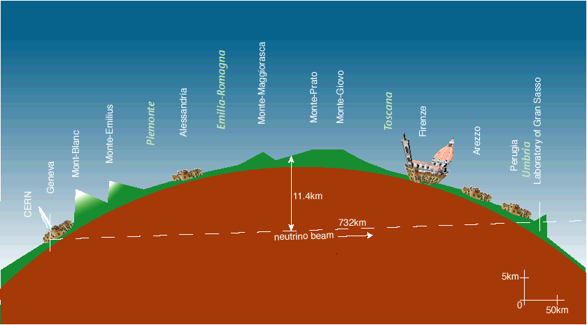
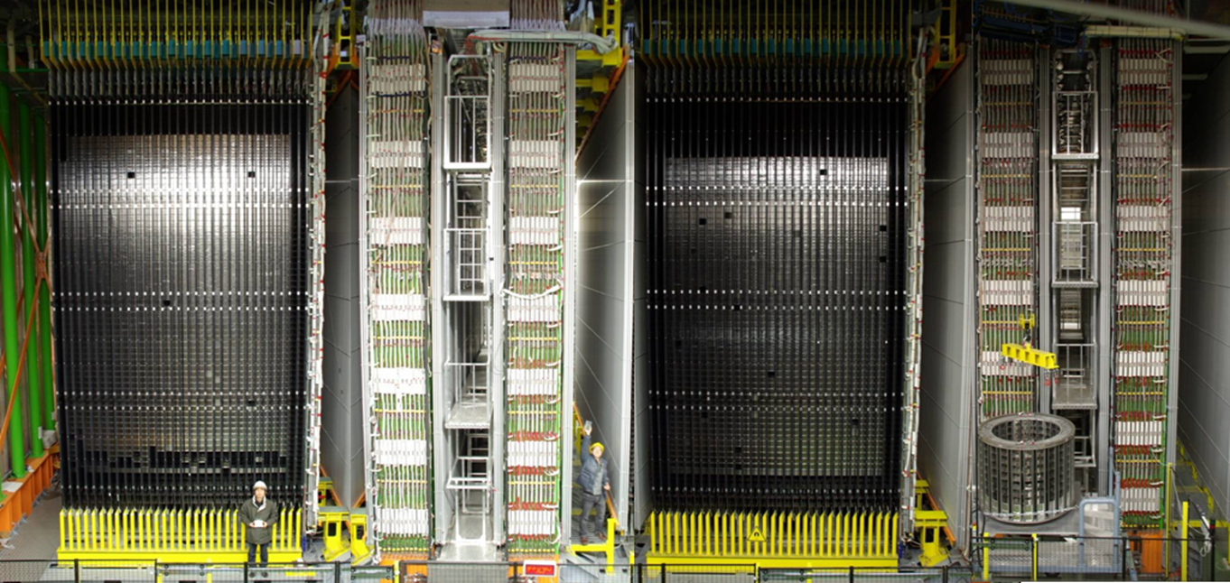
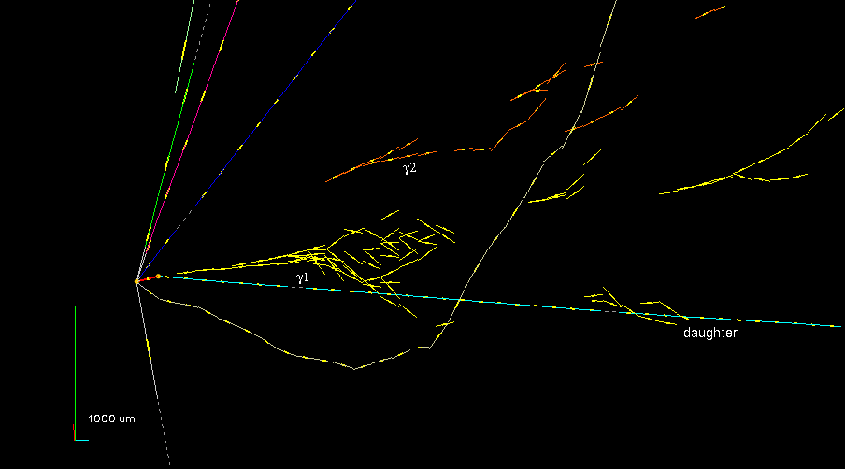
OPERA experiment
J. Kawada
ν_{μ}→ν_{τ} oscillation, ν_{μ}→ν_{e} oscillation
Total target mass of 1.25 kt
CERN
730 km
LNGS
The biggest enterprise ever
About 10,000,000 films ~110,000 m²

Slide 14
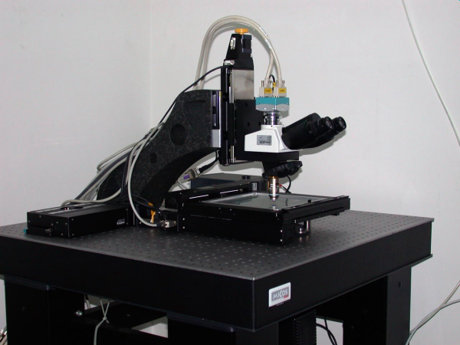
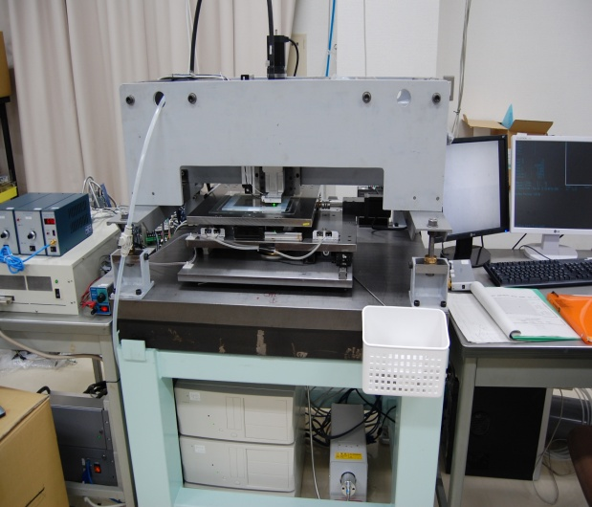
J. Kawada
OPERA Emulsion scanning system
European Scanning System
Super-UltraTrackSelector
High speed automatic microscopes:
~ 200 cm² emulsion film surface/hour/facility
Based on state of the art technologies:
precision mechanics, high-speed CMOS, pattern recognition, image analysis
Data flow: ∼ 1 GB/s/facility

Slide 15
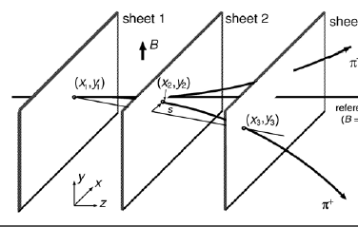
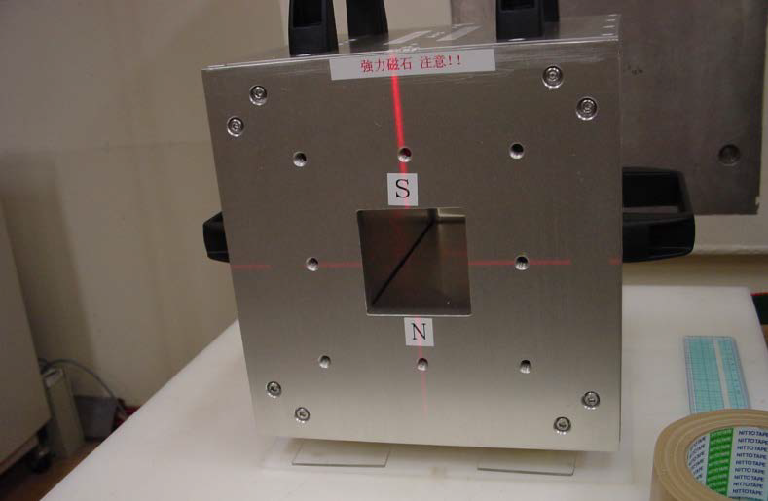
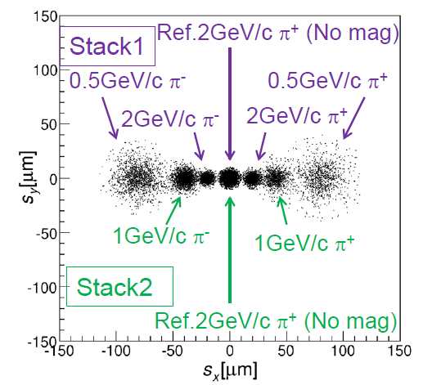
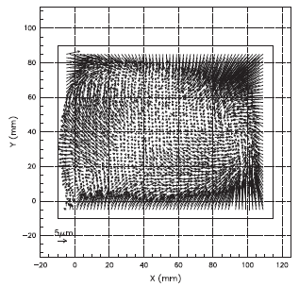
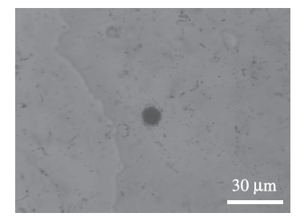
Emulsion Neutrino Spectrometer for future neutrino experiments
H. Shibuya
A detector which can identify all the neutrino flavor is strongly required for future neutrino experiments

Slide 16
2nd day

Slide 17
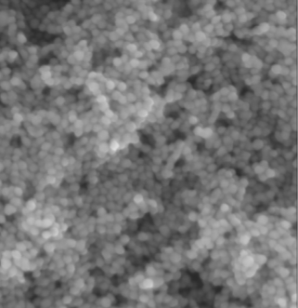
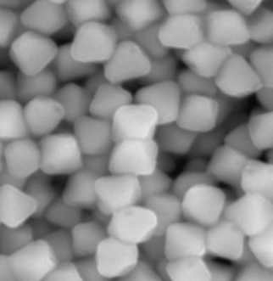
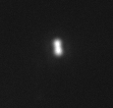



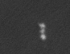
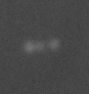
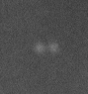
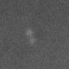
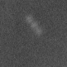
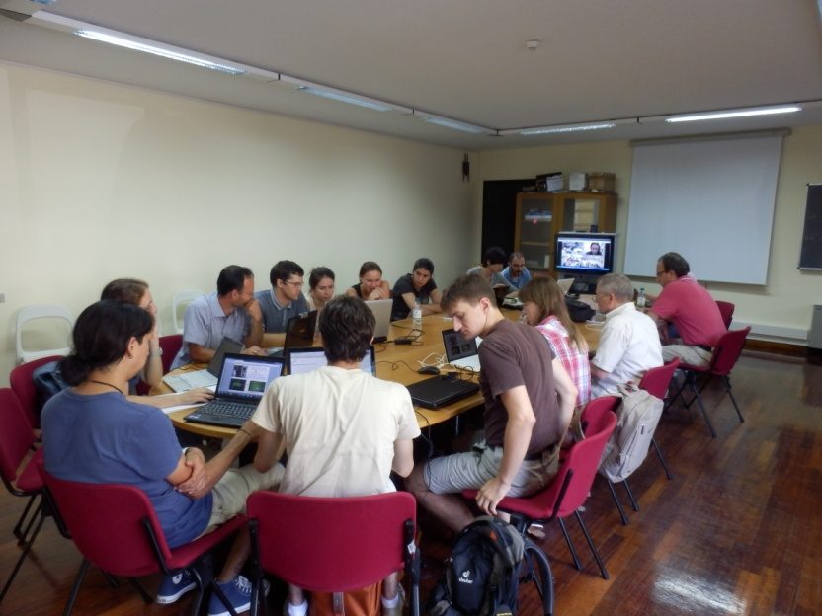
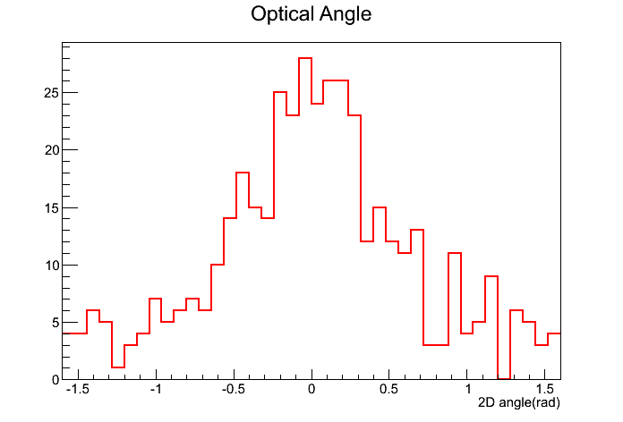
Directional Dark Matter Search
With Ultra Fine Grain Nuclear Emulsion
T. Asada
Fine grain crystals produced in Nagoya University
WIMP wind
35nm crystal
200nm crystal
Nuclear emulsion
WIMP wind
WIMP
Optical
Heavy nuclei recoils by 14MeV neutron
For dark matter
500nm
Kr 200keV
200nm
X-ray
236nm
600nm
330nm
486nm
DM collaboration is starting.
1g scale test run at LNGS

Slide 18
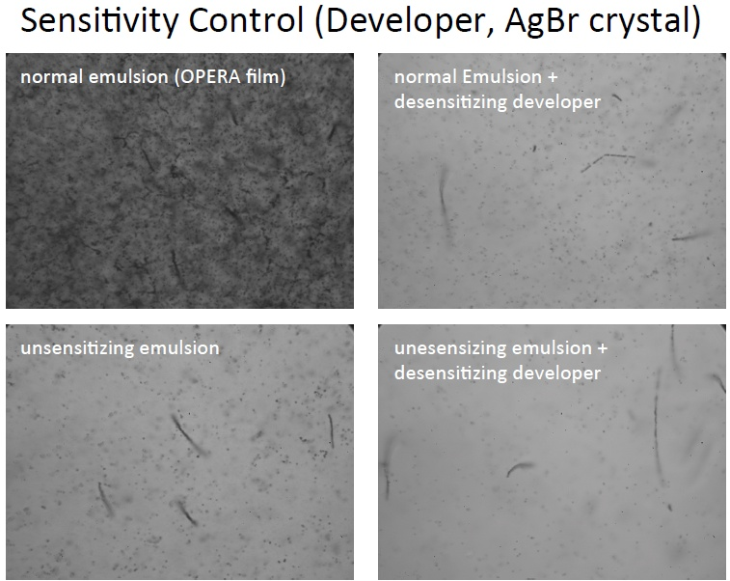
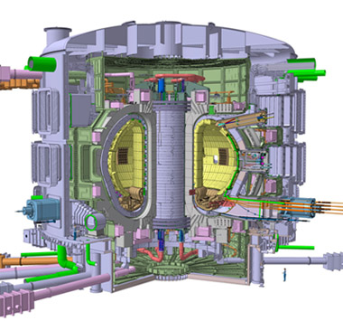
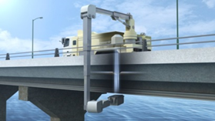
Development of fast neutron and proton detector in high gamma ray fields
K. Morishima
Fast Neutron Imaging for non--‐destructive Inspec7on of large--‐scale concrete fstructure

Slide 19
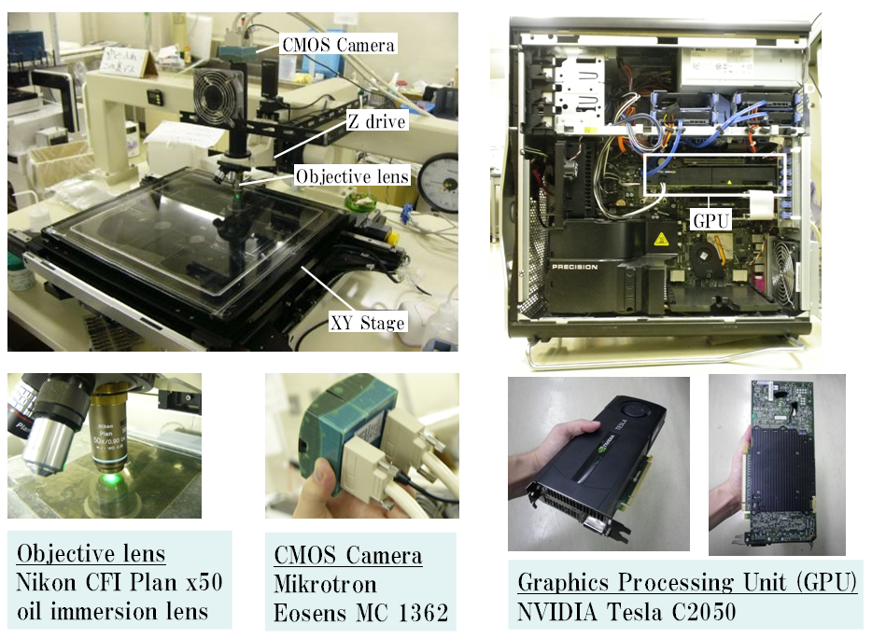
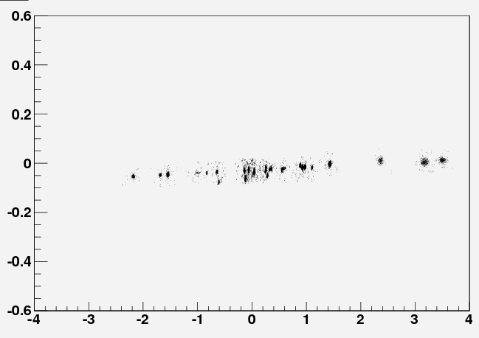

Automated analysis of nuclear emulsions using new tracking technique
T. Fukuda
FTS : “Large angle tracking” and “High discriminated tracking”

Slide 20






Implantation of heavy ions ⁸⁶Kr and ¹³²Xe in emulsion with energy 1.2 A MeV
K. Mamatkulov
Demonstrate Slavich film.
Check the range of Kr, Xe ions for the calibration of fission study.
Kr
Xe

Slide 21




Study of light nuclei cluster structure with nuclear track emulsion (Becquerel)
D. Artemenkov
¹²C→3α , 3.65 A GeV
⁹Be→2α
(1.2 A GeV)
¹⁰C→2α+2p
(1.2 A GeV)
⁷Be→α+³He (2³He)
⁷Be→⁶Be→α+2p
(1.2 A GeV)
Some data/model (CHIPS) observed.
Mean free path of studied nuclei in NTE
experiment
model

Slide 22



Electromagnetic dissociation simulation with FLUKA (Becquerel)
M. I. Cherciu
¹⁶O
Bigger discrepancy at high Z atoms?
³²S

Slide 23





High speed automatic scanning systems
(past, present and future R&D in Italian labs)
V. Tioukov
Software base upgrade of the OPERA European scanning system.
Already 50,000 cm² scanned.
1 rad
0.5 rad
CPU
~550 ms/view
Test beam
Cosmic
Ranking
GPU
61 ms/view
Theta

Slide 24







ATMic: Fast 4π tracking based on GPUs and its framework
A. Ariga
Image display
New framework for general purpose emulsion scanning.
- from data taking to analysis
High performance and flexibility.
Tracking using GPU
Angle as 3D unit vector, VX-VY
Cosθ distribution
θ : azimuthal angle
Horizontal
Vertical

Slide 25




Super Fast Automated Emulsion Scanning System ~ HTS ~
M. Yoshimoto
※2
Speed in cm²/ hour
~2000m²/year
9000
※1
10000
1000
~20m²/year
72
100
×100
10
1
1
0.082
0.1
0.01
0.003
0.001
TS(TTL)
1983
NTS(CPLD)
1994
UTS(FPGA)
1998
S-UTS
(FPGA)
2006-
Running
HTS
(GPGPU)
2011-
Developing
HTS will be used for Muon radiography and gamma ray telescope (GRAINE project)
Enormous Objective
F.O.V 5x5mm
80kg
cosmic ray muon

Slide 26


Development of muon radiography system
K. Morishima
Application for nuclear power plant

Slide 27





Muon radiography test-2012/2013 of nuclear emulsion detector method
A. Managadze
Result will come

Slide 28




Muon radiography of volcanoes with nuclear emulsions in Italy
V. Tioukov
Stromboli
Data subtracted from MC
some data excess in a crater region

Slide 29


Nuclear emulsion with molybdenum filling for 2β -decay observation
M. Chernyavsky
Fig.4. Image of real emulsion with Mo-conglomerates and simulation of flight two electrons with different energy value
If films corresponding to 10-12 OPERA ECC, filled with 1 kg ¹⁰⁰Мо, are processed on three scanning microscopes for 1 year, the expected result of the decay period measurement is ~1.5x10²⁴ years

Slide 30




3rd day : in Brasov

Slide 31
4th day

Slide 32

Video collections
P. Zarubin, I.G. Zarubina

Slide 33

Proposal on exposures of NTE to beam of ¹¹C nuclei at 400 A MeV
D. Artemenkov
?

Slide 34






Pattern recognition of tracks in nuclear emulsion
N. Starkov

Slide 35




Implantation of ⁸He nuclei in NTE
K. Mamatkulov
Energy Q_{2α} distribution of α particle pairs;
the hatched histogram satisfies the event selection conditions L₁ and L₂ < 12.5 μm.
Angle Θ_{2α} distribution in pairs of α particles
The analysis of 278 decays of ⁸He nuclei can be a prototype for investigating decays of ^{8,9}Li, ^{8,12}B, ⁹C, and ¹²N nuclei in which the ⁸Be nucleus serves as a marker.

Slide 36


New suggestions of studies on physics of nuclear fission
P. Zarubin
Femtosecond Laser , Laser Center Moscow State University

Slide 37


MoDEAL, Monopole and Exotic Detection At the LHC
P. Vlad
LHCb

Slide 38
Friday
Slavich NTE, O. Orurk
Testing of nuclear emulsion prepared in 2012-2013 (Slavich), V. Bradnova
Nuclear emulsions for medical applications, A. Lauria

Slide 39
Discussion
Emulsion: Where to go?
Is the emulsion detector obsolete?

Slide 40
Discussion
Emulsion: Where to go?
Is the emulsion detector obsolete?
  Aki: No. It is now to start the emulsion! The technology of readout have finally caught up with the emulsion detectors. (Speed, amount of data/s)
    Needless to say, the unbeatable spatial resolution!

Slide 41
Discussion
Emulsion gel (Slavich, Nagoya)
Automatic scan
  How to share the expertise of auto scan?
  Common tools?
Physics
  Collaborations
Applications

Slide 42
Physics motivation
OPERA
Super beam
Neutrino
Double beta decay
Dark Matter
AEgIS
Nuclear Physics
Astroparticle
Applications
Nuclear clustering
Gamma ray telescope
Muon radiography
Neutron detection
Medical
Beam monitoring

Slide 43
Scanning Technology
Rare event validation
Manual Auto
Manual scan
Nuclear clustering
Good emulsion
High Precision scan
High speed Scan
Gamma ray telescope
OPERA
AEgIS
Muon radiography
Dark matter
Super beam
Neutron detection
Double beta decay
Beam monitoring
Medical

Slide 44
Emulsion gel
SLAVICH
Nagoya
20 nm
Dark matter
Fine Grain
Nuclear clustering
Double beta decay
200 nm
Gamma ray telescope
AEgIS
OPERA
Beam monitoring
Neutron detection
Super beam
Muon radiography
Medical
High sensitivity
GD 25
GD 50

Slide 45
Emulsion Archive
Archive the legendary experiments
  Intercosmos (4 days in satellite)
  JACEE (balloon, 10 days at south pole)
  CHORUS (200k neutrino interactions)
  E653 (800GeV proton, 600 GeV pion)
Start discussion for a common effort?
  Data format, etc

Slide 46
Conclusion
Nice to meet you!
  People from the different domains
Let’s keep in touch and open the cooperation!

Slide 47

Thank you for the organizers for this nice Workshop!!

Slide 50


